Slide 1

"Uber Care for Elderly"
Introduction:
Developing a mobile app to provide tailored transportation services for the elderly, ensuring their safety and independence.
This app aims to address the specific needs of the elderly population when it comes to transportation. With a user-friendly interface and specialized features, it will make it easier for them to book rides, track their drivers, and communicate their preferences.
By offering reliable and convenient transportation options, we are committed to enhancing the quality of life for the elderly. Our goal is to empower them to maintain their independence and stay connected with their communities.

Slide 2
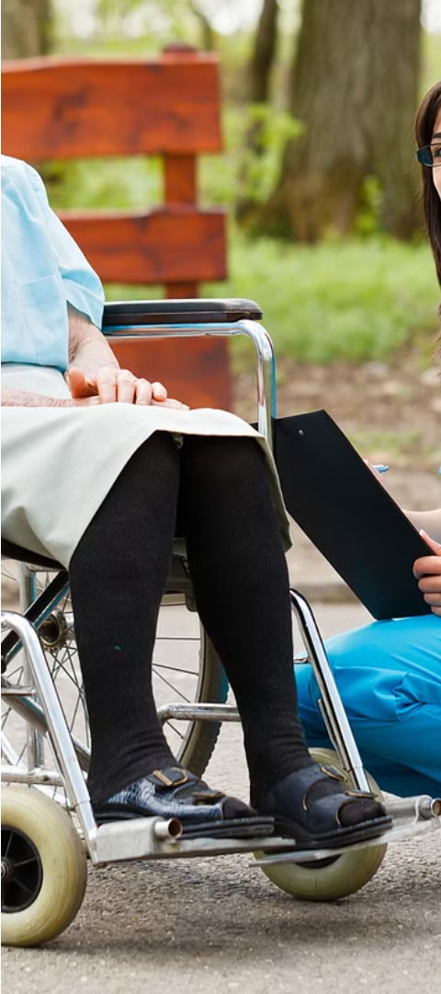
Objectives:
1
Develop a Comprehensive Product Roadmap:
Outline key stages and milestones
Define clear deliverables for each phase
2
Identify and Prioritize Essential Features:
Determine critical features for the initial release.
Prioritize features based on user needs and market demands.
3
Create an effective launch strategy:
Define target market and marketing channels.
Develop tactics to promote user adoption.
Build partnerships and generate buzz around the launch.

Slide 3

High-Level Product Roadmap
1
Research
Conducting market research, user needs analysis, and competitive analysis to inform the app's development.
2
Design
Designing the user experience and interface, creating wireframes and prototypes.
3
Development
Building the backend and frontend, integrating with Uber's existing infrastructure.

Slide 4
Research Phase Deliverables
User Personas
Market Demand Report
Competitive Analysis
Developing detailed user personas to understand the needs and preferences of elderly users.
Evaluating existing solutions and identifying opportunities to differentiate the "Uber Care for Elderly" app.
Analyzing the market demand for specialized transportation services for the elderly.

Slide 5
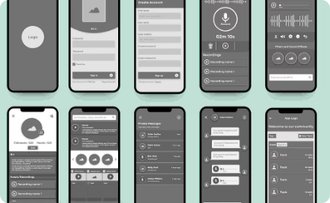
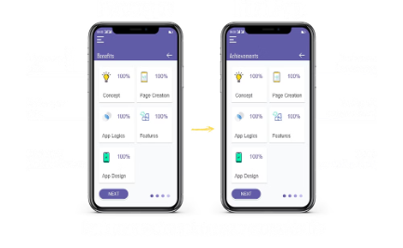

Design Phase Deliverables
Wireframes
Prototypes
Design Specifications
Creating wireframes to define the user interface and user flow.
Developing interactive prototypes to validate the design and gather user feedback.
Documenting the visual design, interaction patterns, and accessibility guidelines.

Slide 6
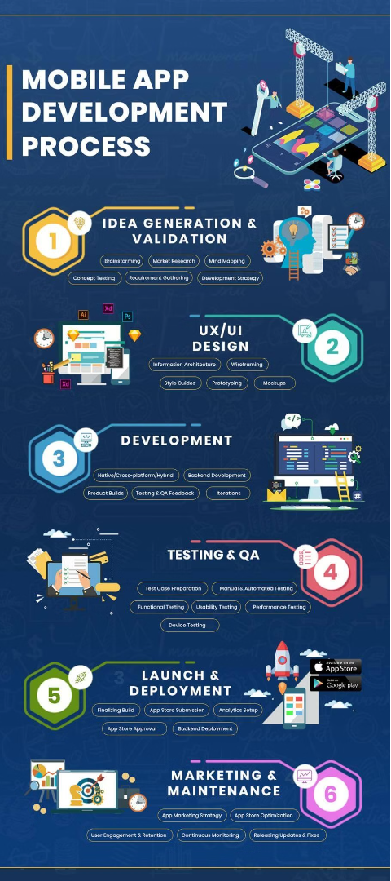
Development Phase Deliverables
Functional App Modules
Integration Points
Building the core features and functionalities of the "Uber Care for Elderly" app.
Seamlessly integrating the app with Uber's existing infrastructure and services.
Backend Development
Implementing the server-side components and APIs to power the app's functionality.

Slide 7
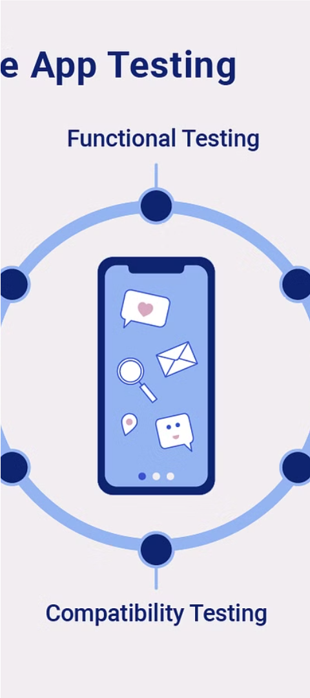



Testing Phase Deliverables
Alpha Testing
Conducting initial testing with a small group of users to identify and fix issues.
Beta Testing
Expanding testing to a larger group of users to gather feedback and refine the app.
User Acceptance Testing
Ensuring the app meets the requirements and expectations of the target audience.

Slide 8

Deployment Phase
1
Final Preparations
Finalizing app features, testing, and quality assurance before launch.
2
App Store Submission
Submitting the app to the relevant app stores for review and approval.
3
Key Deliverables
Deployed app, app store listings, and marketing materials ready for launch.

Slide 9




Essential Features for Initial Release
User-Friendly Interface
Easy Booking
Safety Features
Tailored Payment
Simplified booking and scheduling process for transportation services.
Emergency contacts, real-time tracking, and other safety measures.
Intuitive and easy-to-navigate app design for elderly users.
Payment options designed with the needs of elderly users in mind.

Slide 10
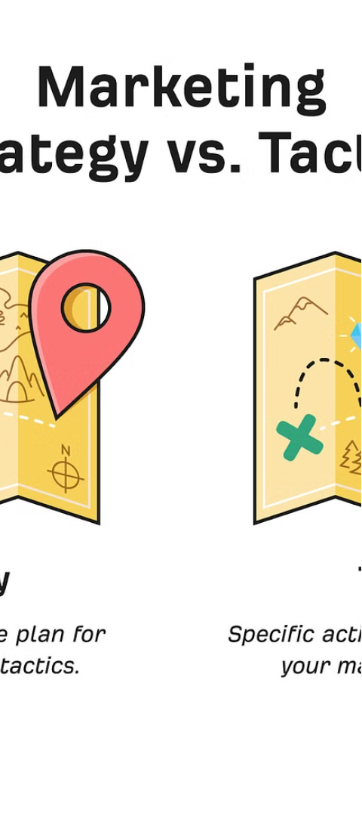
Launch Strategy Overview
Target Market
Marketing Channels
Elderly individuals, caregivers, and assisted living communities.
Social media, community centers, online/offline advertising, and healthcare partnerships.
Tactics
Free trials, referral programs, demonstrations, and influencer collaborations.

Slide 11

Target Market
1
Elderly Individuals (65+)
2
Caregivers and Family Members
The primary target audience for the "Uber Care for Elderly" app.
Individuals responsible for the care and transportation of elderly loved ones.
3
Assisted Living Communities
Facilities that can benefit from the app's specialized transportation services.

Slide 12



Marketing Channels
Social Media
Community Centers
Online and Offline Ads
Healthcare Partnerships
Leverage platforms like Facebook and Instagram to reach the target audience.
Engage with senior organizations and local community centers.
Utilize a mix of digital and traditional advertising channels.
Collaborate with healthcare providers to promote the app.

Slide 13




Marketing Tactics
Free Trials
Referral Programs
Demonstrations
Influencer Collaborations
Offer users the opportunity to try the app for free.
Host workshops and demonstrations at senior centers.
Incentivize existing users to refer the app to their network.
Partner with influential figures in the elderly care sector.

Slide 14
Building Partnerships
Healthcare Providers
Senior Living Facilities
Government Programs
Partner with healthcare providers and insurance companies to integrate the app into their services.
Collaborate with assisted living communities to offer the app as a transportation solution.
Engage with local government initiatives and programs focused on elderly care and mobility.

Slide 15

Generating Buzz
Press Releases
Launch Events
User Testimonials
Leverage media coverage to generate awareness and interest in the app.
Host engaging community events to introduce the app and its features.
Showcase real-life success stories and the positive impact of the app.

Slide 16
Conclusion
Summary of Key Elements:
Recap of the product roadmap stages and key deliverables
Highlight the prioritized features and their importance
Emphasize the launch strategy and its components
Final Thoughts:
The "Uber Care for Elderly" initiative has a significant impact on improving elderly mobility and quality of life. We invite all stakeholders and partners to support this important cause.

Slide 17
Thank You
Name -- Aman Bhardwaj
Roll No. -- 2022PBA9271
E mail -- aman.bhardwaj.mba22@gmail.com

